Slide 1
Riley County Community Health Improvement
Planning Meeting
March 5, 2015

Slide 2
Welcome!

Slide 3
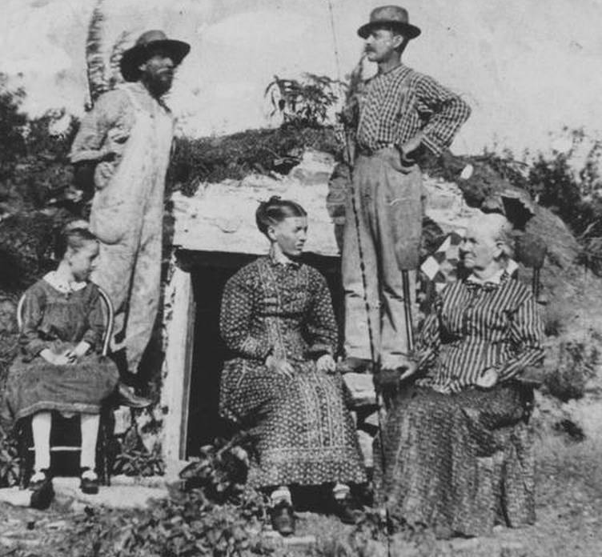

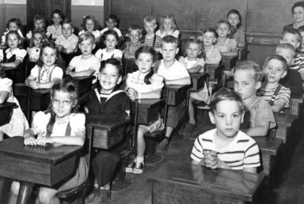
Can we Make a Difference in our Community’s Health?

Slide 4

Aligning Assessments Efforts
Multiple related efforts have been taking place over the past several months
Comprehensive Community Needs Assessment
Community Survey – over 1,000 respondents
Stakeholder Interviews
Focus Groups
Data Review
Local Public Health Systems Performance
Review of the Public Health System by Subject Matter Experts and Community Stakeholders
Community Health Improvement Plan
Determining top health priorities to address and improve through coordinated efforts in the next 3-5 years.
Many community partners have been involved

Slide 5

Comprehensive Community Needs Assessment
Key Partners
Project coordination provided by
Riley County
Seniors’ Service Center
Funding provided by:
Caroline F. Peine Charitable Foundation (Manhattan Fund)
Konza United Way
Mercy Regional Health Center
Riley County Council on Aging
Wamego Health Center
Conducted by Center for Community Support & Research
Wichita State University
Design Team Members:
Konza United Way
Mercy Regional Health Center
Riley County Health Department
Riley County Seniors’ Service Center
For full report, see www.rileycountycommunityneedsassessment.org

Slide 6
Community Meetings for Public Input
Please help publicize and consider attending!
✓ Thursday, January 29
Manhattan – Community Leader Meeting
✓Sunday, February 8
Manhattan
2-3:30pm
✓ Wednesday, Feb. 25
Keats
7:30-8:30pm
TBD
Spanish-speaking
✓ Thursday, February 12
Manhattan
1-2:30pm
✓ Monday, Mar. 2
Randolph
12:00-1:00pm
April 9
First United Methodist Church
Manhattan
3:00-5:00pm
Next steps – all are welcome!
✓ Wednesday, February 18
Riley
6:30-8:00pm
✓ Wednesday, Mar. 4
Randolph
7:00-8:00pm
✓ Tuesday, February 24
Ogden
6:00-7:30pm
Thursday, March 5
Leonardville
6:30-8:00pm

Slide 7


Two Types of Data Presented Today – Both are valuable!
Perception (what we think is true or most important about our community)
  Comprehensive Community Needs Assessment (CCNA) survey results
  Local Public Health Systems Assessment scoring and comment results
Representative Data (what is true or representative of our community)
  CCNA – included data from other sources
  Census (e.g., populations, income, poverty)
  Health vital statistics (e.g., birth and death data)
  Behavioral Risk Factor Surveillance System survey – self-reported health risk data (e.g., diagnosed with high blood pressure, eat fruits and veggies)
  Other sources
Sometimes the same

Slide 8
Participant Worksheet Instructions
Actively listen and take notes!

Slide 9

Demographic Overview
- Population Distribution

Slide 10
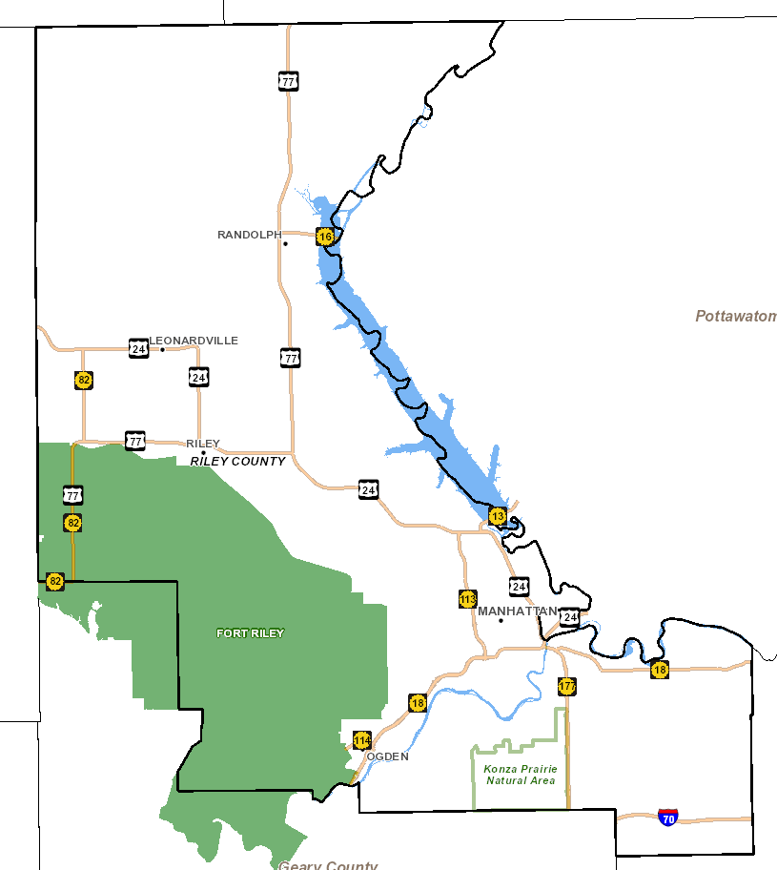
Notes:
2011-2013
Riley Co: 74,893
Manhattan: 55,483

Slide 12
* 2009 – 2013 ACS Census Estimates

Slide 13
* 2009 – 2013 ACS Census Estimates

Slide 14
Socioeconomic Overview
- Income
- Education

Slide 15
* 2009 – 2013 ACS Census Estimates

Slide 16
* 2009 – 2013 ACS Census Estimates

Slide 17
* 2009 – 2013 ACS Census Estimates
Notes:
1 person – about $12,000
2 people – about $16,000
Family of 4 with 2 adults and 2 children < 18 – about $24,000

Slide 18
* 2011 – 2013 ACS Census Estimates

Slide 19
* 2009 – 2013 ACS Census Estimates

Slide 20
Riley County Comprehensive Community Needs Assessment (CCNA)
Overview

Slide 21



“The overarching theme of the data collected is that Riley County is a community that is divided between a high quality of life, prosperity, and growth on one hand, and dwindling resources for and lack of attention to those who are most in need on the other.”
21

Slide 22
Overview of CCNA Findings
High quality of life
Growth
Spirit of community and collaboration
“Invisible” population with significant needs
Lack of accessible and affordable mental health services
Lack of affordable housing
Lack of accessible and affordable child care

Slide 23
Quality of Life
Riley County Comprehensive Community Needs Assessment

Slide 24

Quality of Life Findings
Percent respondents who “agree” or “strongly agree”
88% There are opportunities to volunteer in my community
87% This is a safe place to live
86% This is a good place to raise children
85% This is a beautiful place to live
82% I am satisfied with the quality of life in this community
41% I am satisfied with local government
39% All residents think that they can make the community a better place to live

Slide 25
Quality of Life: High-Low Game
Which did respondents score most important? (The rest were least important.)
Resources for Parents
Good schools
Low disease rates
Low level child abuse
Low disease rates

Slide 26






Most Important Factors that Contribute to Quality of Life
Percent respondents who selected these among their top three:
33% Good schools
30% Good place to raise children
25% Clean environment
24% Safe neighborhoods
19% Healthy economy
18% Low crime

Slide 27
Physical Health
Riley County Comprehensive Community Needs Assessment

Slide 28
Physical Health: High-Low Game
Which did respondents score, on average, as highest and lowest physical health needs?
Maternal health services
Prevention of infant mortality
Affordable health services
Tobacco cessation (quitting) services

Slide 29





Top three needs related to physical health in your community?
Percent respondents who selected these among their top three:
34% Affordable health services
30% Affordable health insurance
29% Facilities for physical activity (including parks, trails, rec centers)
22% Increased health education/prevention
19% Affordable prescriptions
17% Access to healthy food options

Slide 30
Health Data from Secondary Sources (2013 data, unless otherwise indicated) | Kansas | Riley County
Percent adults with fair or poor self- perceived health status | 15.4% | 8.7%
Percent population without health insurance | 12.3% | 6.2%
Percent adults with hypertension | 31.3% | 18.9%
Percent adults tested and diagnosed with high cholesterol | 38.1% | 28.6%
Percent adults diagnosed with diabetes | 9.6% | 4.5%
Rate of age-adjusted cancer (all cancers, per 100,000, 2007-2011) | 21.1 | 15.5

Slide 31
Health Data from Secondary Sources (2013 data, unless otherwise indicated) | Kansas | Riley County
Percent adults who are obese | 30.0% | 20.7%
Percent adults living with a disability | 21.1% | 15.5%
Percent adults not participating in the recommended level of physical activity (aerobic and/or strengthening) | 82.1% | 73.4%
Percent adults reported consuming fruit less than one time per day | 41.7% | 44.6%
Percent adults consuming vegetables less than one time per day | 22.9% | 27.3%
Percent adults who currently smoke cigarettes | 20.0% | 19.8%

Slide 32
Mental Health
Riley County Comprehensive Community Needs Assessment

Slide 33
Mental Health: High-Low Game
Which did respondents score as the highest need? (Other two scored lowest compared to all choices given.)
Affordable mental health services
Availability of transportation services for mental health
Affordable prescriptions

Slide 34



Top three needs related to mental health in your community?
Percent respondents who selected these among their top three:
40% Affordable mental health services
36% Affordable health insurance that includes mental health
32% High quality mental health services
28% Increased mental health education/prevention
27% Increased number of mental health providers

Slide 35
Data from Secondary Sources (2013 data, unless otherwise indicated) | Kansas | Riley County
Percent of adults reporting that mental health was not good on 14 or more days in the past 30 days | 9.7% | 9.8%
Percent of adults ever diagnosed with a depressive disorder | 18.1% | 23.9%

Slide 36
Social Issues
Riley County Comprehensive Community Needs Assessment

Slide 37
Social Issues: High-Low Game
Which did respondents score as the highest issue of concern?
Youth/gang violence
Elder abuse
Teen pregnancy
Inattentive driving

Slide 38

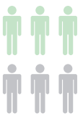

Top three social issues that are of most concern in your community?
Percent respondents who selected these among their top three:
27% Inattentive driving
27% Drinking and driving
26% Poverty
24% Youth drug or alcohol use
19% Mental illness
18% Adult drug or alcohol use

Slide 39

Top three needs related to social issues in your community?
Percent respondents who selected these among their top three:
34% Availability of services for people with low incomes
26% Positive activities for youth
25% Availability of employment
22% Availability of mental health services
20% Child care

Slide 40
Data from Secondary Sources (2012 data, unless otherwise indicated) | Kansas | Riley County
Percent of persons with food insecurity | 15.0% | 16.2%
Percent of adults who are binge drinkers (2013) | 15.4% | 24.4%

Slide 41
Children and Youth
Riley County Comprehensive Community Needs Assessment

Slide 42
Children & Youth: High-Low Game
Which did respondents score as highest needs for children and youth?
Dental care
Transportation
Medical care

Slide 43



Top three needs related to children in your community?
Percent respondents who selected these among their top three:
23% Child care for children 0-5
23% Financial assistance to families (for nutrition, child care, housing, etc.)
22% After school programs
18% Parenting education/skills development
17% Recreational activities

Slide 44

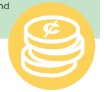
Top three needs related to youth in your community?
Percent respondents who selected these among their top three:
21% Employment opportunities for teens
18% Opportunities to contribute to the community
17% Financial skills training
15% Recreational activities
14% Bullying/relationship violence prevention
14% Appropriate internet/technology use

Slide 45
Data from Secondary Sources (2012 data, unless otherwise indicated) | Kansas | Riley County
Percent of births with inadequate prenatal care | 11.7% | 13.4%
Percent of premature births (2010 – 2012) | 8.9% | 8.1%
Infant mortality rate (2009 – 2013) | 6.4 | 6.2

Slide 46
Education
Riley County Comprehensive Community Needs Assessment

Slide 47
Education: High-Low Game
Which did respondents score as highest need?
Raising standardized test scores
Updated text books
Condition of school buildings
Getting & keeping good teachers
More extracurricular activities

Slide 48

Top three needs regarding education in your community?
Percent respondents who selected these among their top three:
35% Getting and keeping good teachers
18% Increased parental involvement
16% Increased expectations for student achievement
16% Equality in funding among school districts
In general, respondents rated the quality of schools and teachers very high.

Slide 49
Aging
Riley County Comprehensive Community Needs Assessment

Slide 50
Aging: High-Low Game
Which did respondents score as the highest need?
Elder abuse
Affordable housing
Substance abuse
Hospice
Utility assistance

Slide 51


Top three needs for older adults in your community?
Percent respondents who selected these among their top three:
22% Affordable housing
19% Independent living at home
16% Transportation
13% Ease of mobility in the community
13% Affordable prescriptions

Slide 52
Housing
Riley County Comprehensive Community Needs Assessment

Slide 53
Housing: High-Low Game
Which did respondents score as the highest need?
Affordable housing options
Historic preservation
Education about responsible homeownership

Slide 54



Top three needs related to housing in your community?
Percent respondents who selected these among their top three:
52% Affordable housing
26% Assistance with property repair and maintenance
26% Higher quality rentals
24% Code enforcement
20% Neighborhood improvement programs

Slide 55
Transportation
Riley County Comprehensive Community Needs Assessment

Slide 56
Transportation: High-Low Game
Which did respondents score as the highest need?
Build new roads
Increase options for overnight public parking
Widen existing roads
Improve public transit service
Improve driver education

Slide 57

Top three transportation-related needs in your community?
Percent respondents who selected these among their top three:
40% Improve public transit service
32% Develop a pedestrian-friendly transportation system to make areas more walkable
31% Provide maintenance and improvements to existing facilities
28% Expand and improve the bike route system
26% Address texting and driving

Slide 58
Data from Secondary Sources (2013 data, unless otherwise indicated) | Kansas | Riley County
Percent adults who reported they do not always wear a seatbelt when they drive or ride in a car | 17.0% | 12.3%
Age-adjusted traffic injury mortality rate (2011-2013 per 100,000) | 13.3 | 10.0

Slide 59
Infrastructure
Riley County Comprehensive Community Needs Assessment

Slide 60




How would you rate the following public services/features?
Highest rated services:
Library facilities
Fire department
Emergency services
Air quality
Clean environment
Lower rated services (still averaged fair-good):
Paths/safe options for biking and walking
Code enforcement for private properties
Road maintenance

Slide 61
Economics and Personal Finance
Riley County Comprehensive Community Needs Assessment

Slide 62
Economics and Personal Finance: High-Low Game
Which did respondents score as the highest need?
Employment opportunities for youth
Employment opportunities for older adults
Access to education
Availability of jobs

Slide 63


Top three economic/personal finance needs in your community?
Percent respondents who selected these among their top three:
36% Availability of jobs
21% Emergency assistance to individuals or families
21% Assistance with searching for and gaining employment
20% Small business development
19% Low-cost resources to help with personal finance management

Slide 64
Review of Key Findings
Riley County Comprehensive Community Needs Assessment

Slide 65
“The overarching theme of the data collected is that Riley County is a community that is divided between a high quality of life, prosperity, and growth on one hand, and dwindling resources for and lack of attention to those who are most in need on the other.”
65

Slide 66
Overview of CCNA Findings
High quality of life
Growth
Spirit of community and collaboration
“Invisible” population with significant needs
Lack of accessible and affordable mental health services
Lack of affordable housing
Lack of accessible and affordable child care

Slide 67
Leading
Causes of
Death
Riley County Comprehensive Community Needs Assessment

Slide 68
Leading Causes of Death
(2009-2013)
Kansas
Cancer
Heart Disease
Chronic Lower Respiratory Diseases
Unintentional Injuries
Stroke
Alzheimer’s Disease
Diabetes
Pneumonia & Influenza
Kidney Disease
Suicide
Riley County
Cancer
Heart Disease
Stroke
Chronic Lower Respiratory Diseases
Unintentional Injuries
Pneumonia & Influenza
Alzheimer’s Disease
Diabetes
Kidney Disease
Suicide

Slide 69
Comparison Areas
Largest city in each county?
Kansas
Riley
Geary
Pottawatomie
Douglas

Slide 74
Key Health Indicators
Riley County Comprehensive Community Needs Assessment

Slide 75
Infant Mortality Rate
County with highest rate?

Slide 77
Percent of Births Where Mother Smoked During Pregnancy
County with highest rate?

Slide 83
Percentage of Adults who are Binge Drinkers
County with highest rate?

Slide 85
Percentage of Adults who Smoke Cigarettes
County with highest rate?

Slide 88
Percentage of Adults with no Personal Doctor or
Health Care Provider
County with highest/ lowest percentage?

Slide 90
Percent Obese
County with lowest rate?

Slide 93
Percentage of Adults with Consuming Fruit, Vegetables Less than 1 Time Per Day
County with highest/ lowest rate?

Slide 96
Mental Health
County with highest rates on related indicators?

Slide 99
Local Public Health Systems Assessment

Slide 100
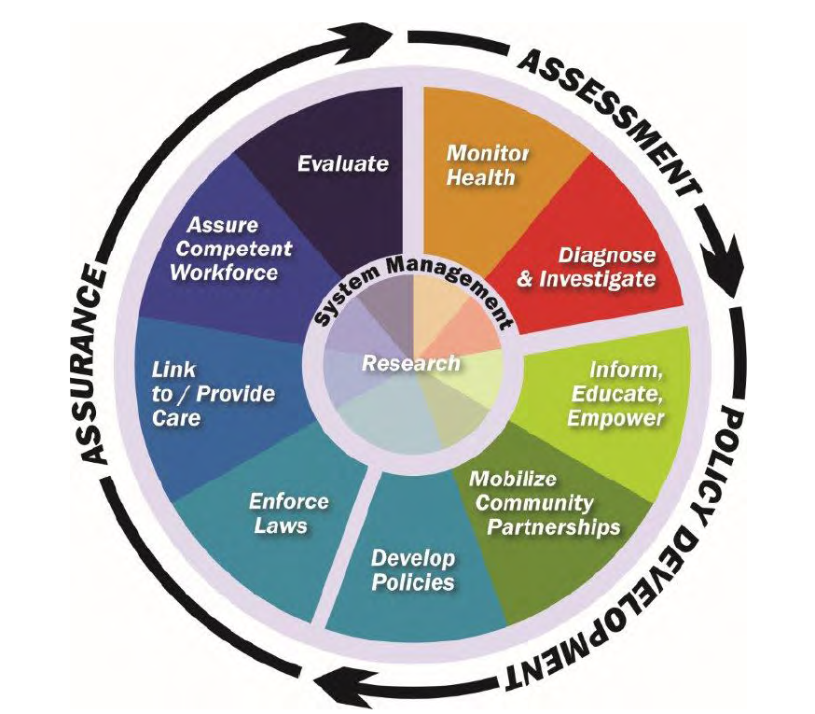
Local Public Health Systems Assessment (LPHSA)
What is public health? Activities that society undertakes to assure the conditions in which people can be healthy.
  The public health system is more than the public health agency…it involves all public and private entities that contribute to public health and the health and well-being of a community.
10 Essential Public Health Services provided the framework for the assessment instrument
10 services and related “model standards” describe an optimal level of performance and capacity
Approximately 100 people participated in the assessment in June 2014
See report for detailed description of scoring instrument, process, and results

Slide 101
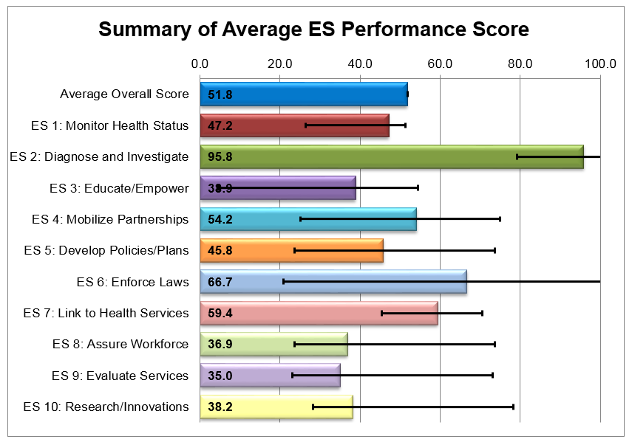
Local Public Health System Assessment (LPHSA) Results
Overall, the Riley County Public Health System scored very favorably
No essential services performed in the “No Activity” (0%) or “Minimal Activity” (1-25%) range.

Slide 102

Overall LPHSA Observations
Much work is being done (lots of resources, lots of organizations, doing a lot of good things)…but many (including community leaders, providers, organizations, and the public) don’t know about it
Some essential services are lacking a central authority or lead organization to take fully implement or utilize resources in an intentional, coordinated way
Need for increased communication, coordination, and linkages within the local public health system
Need to expand local public health system’s ability to share and use data and informational resources
General lack of awareness the public health system
Concerns related to mental health
Concerns related to Northern Riley County

Slide 103
Facilitated
Group Discussion:
In your opinion, what are the top health needs that must be addressed in the next 3-5 years?

Slide 104
Large Group Voting –
Distribute your dots (votes) in any way you choose

Slide 105
Resources
Riley County Community Health Improvement Planning process and meetings:
datacounts.net/rcchip/
Riley County Comprehensive Community Needs Assessment Results:
www.rileycountycommunityneedsassessment.org
Riley County Local Public Health System Assessment Results:
datacounts.net/lphsa/

Slide 106
Thank you!

